Slide 1



Buccaneers of the Binary
Plundering Compiler Optimizations for Decompilation Treasure
Zion Leonahenahe Basque

Slide 2




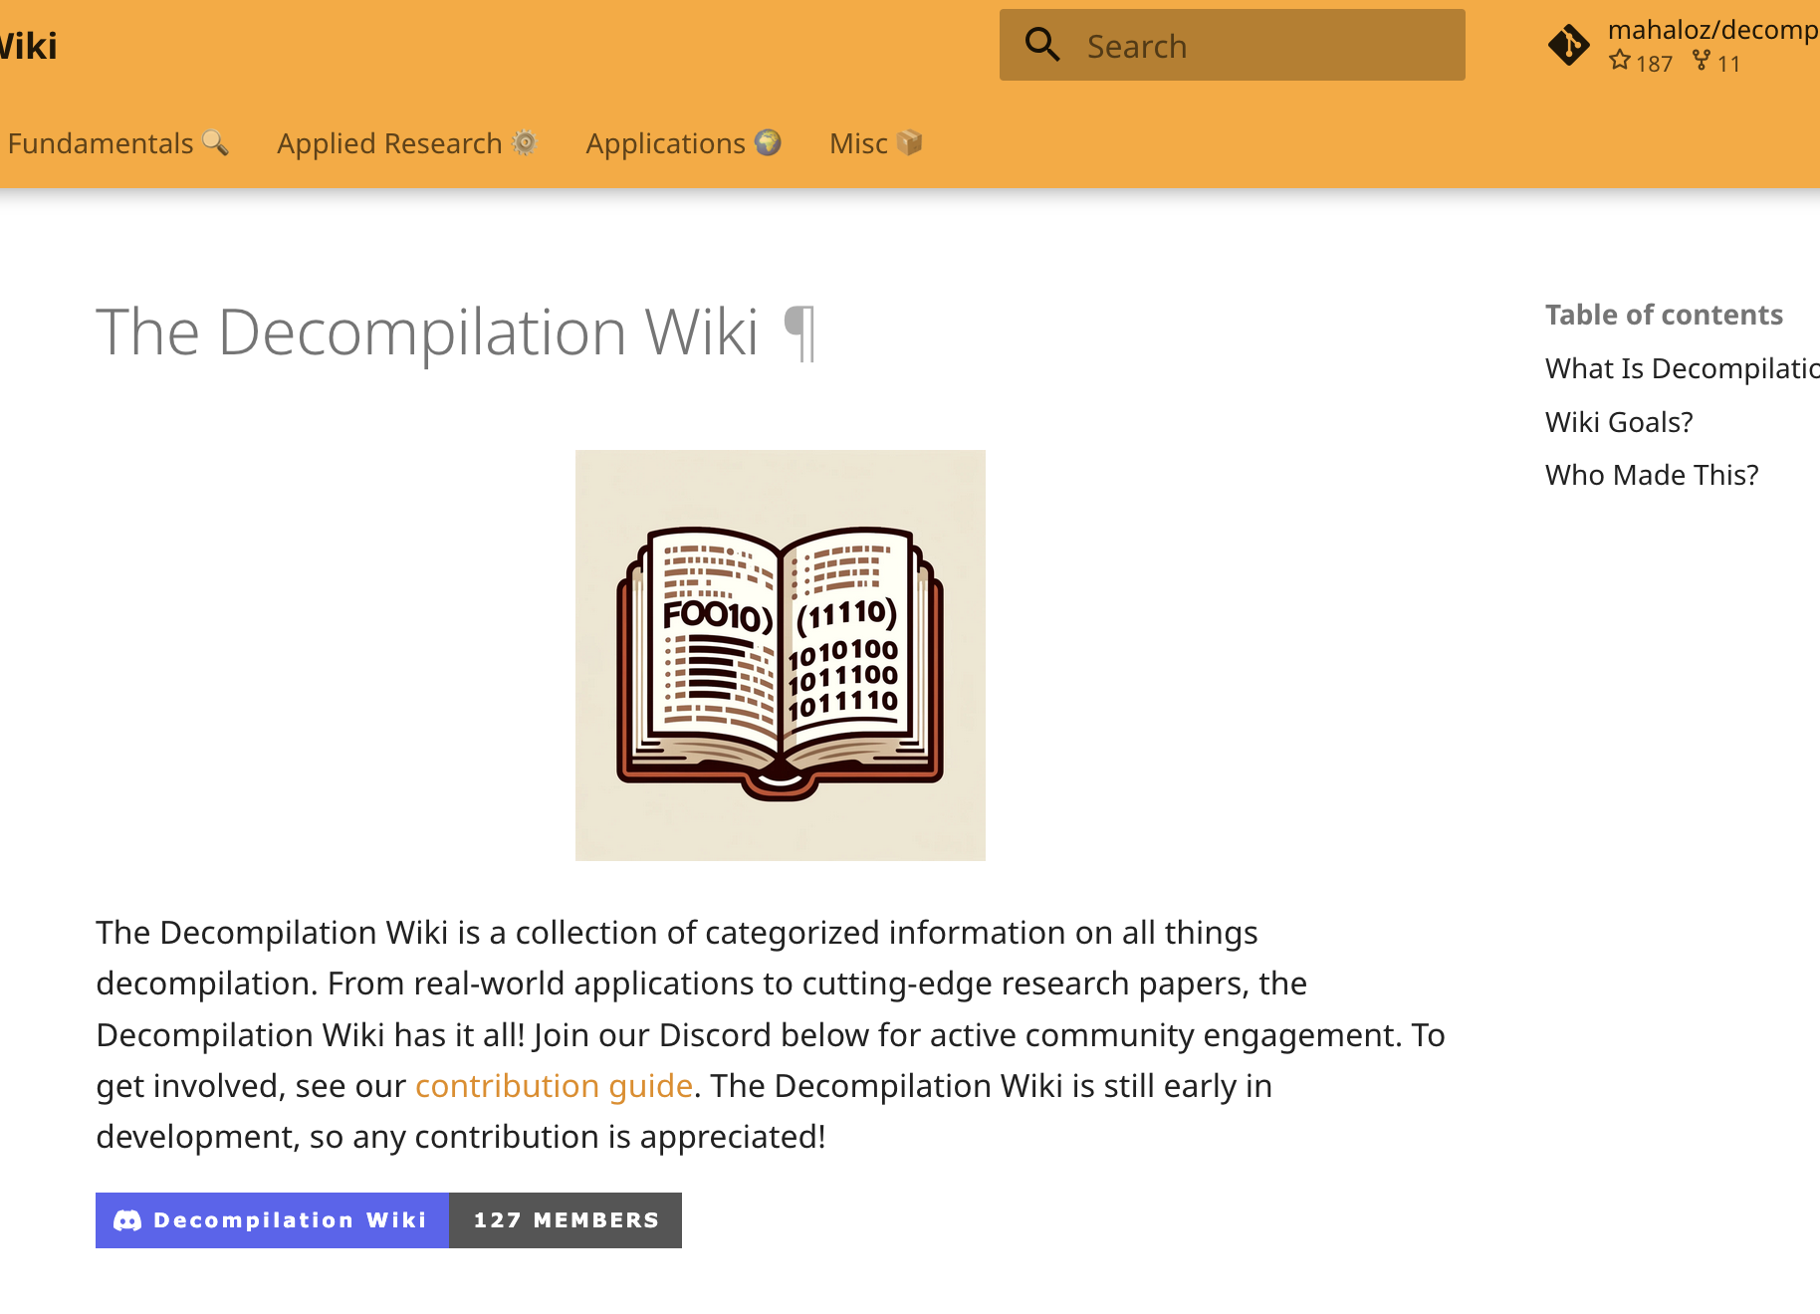
$ whoami
@mahal0z

Slide 3
$ whoami: summary
I nerd over/study decompilers
I am an active decompiler user! (CTFer)
I hate pineapple pizza

Slide 4
Talk Goals
REBELLION and demand better decompilers
OR
Give our angr decompiler a shot

Slide 5



Reverse Engineers Fight Binaries

Slide 6
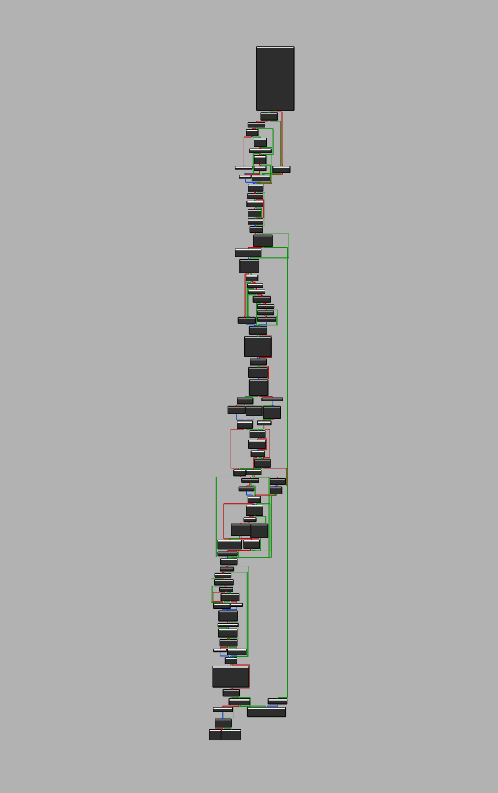
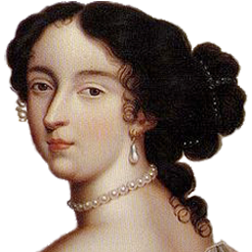
What is a Disassembler?
(disassembling)

Slide 7
What is a Decompiler?
(decompiling)
if (welcome) puts("hello!"); puts("goodbye"); return 0;

Slide 8

What is a Decompiler? A Simple Code Generator…
(decompiling)
if (welcome) puts("hello!"); puts("goodbye"); return 0;

Slide 9

What is a Decompiler? A Complex Code Generator...
while ( 1 ) { v8 = getopt_long(v4, (char *const *)v5, "0123456789cstuw:p:g:", long_options, 0LL); if ( v8 == -1 ) break; if ( v8 == 112 ) { v9 = optarg; prefix_lead_space = 0; if ( *optarg == 32 ) { do v10 = 1 - (_DWORD)optarg + (_DWORD)v9++; while ( *v9 == 32 ); prefix_lead_space = v10; } prefix = v9; prefix_full_length = strlen(v9); v11 = &v9[prefix_full_length]; if ( v9 < v11 ) { do { if ( *(v11 - 1) != 32 ) break; --v11; } while ( v9 != v11 ); // ... if ( v8 != 103 ) goto LABEL_53; v7 = optarg; } } else if ( v8 == 116 ) { tagged = 1; } else if ( v8 <= 116 ) { if ( v8 != 115 ) goto LABEL_53; split = 1; } else if ( v8 == 117 ) { uniform = 1; } else { if ( v8 != 119 ) goto LABEL_53; v3 = optarg; } if ( !v7 ) { LABEL_50: goal_width = 187 * max_width / 200; goto LABEL_37; } v27 = dcgettext(0LL, "invalid width", 5); goal_width = xdectoumax(v7, 0LL, 0x4BuLL, "", v27, 0); max_width = goal_width + 10; LABEL_37: v15 = optind; // ... }
(decompiling)

Slide 10



Even Simple Cases Are Hard
if (v1 && v2) { puts("1"); puts("2"); goto B; } puts("2"); if (v2) { B: puts("3"); } return 0;
if (a && b) puts("1"); puts("2"); if (b) puts("3"); return 0;

Slide 11
Even Simple Cases Are Hard
if (v1 && v2) { puts("1"); puts("2"); goto B; } puts("2"); if (v2) { B: puts("3"); } return 0;
if (a && b) puts("1"); puts("2"); if (b) puts("3"); return 0;

Slide 12
Even Simple Cases Are Hard
if (v1 && v2) { puts("1"); puts("2"); goto B; } puts("2"); if (v2) { B: puts("3"); } return 0;
if (a && b) puts("1"); puts("2"); if (b) puts("3"); return 0;
Why the goto?

Slide 13
Is decompilation really that broken? A Real-World Case Study

Slide 14
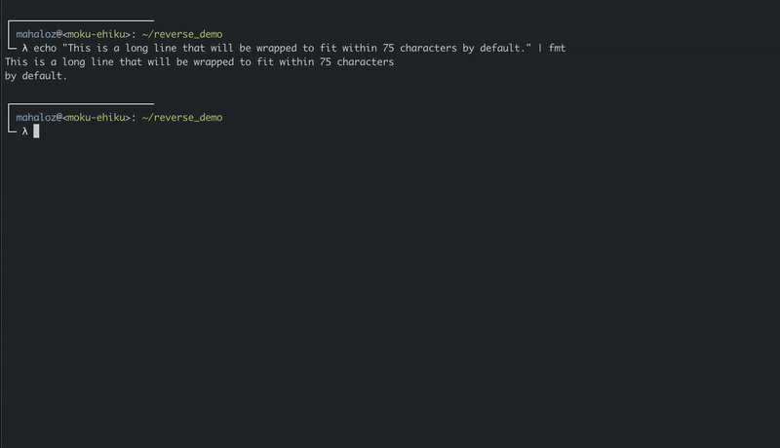
fmt: Your Favorite Built In Text Formatter

Slide 15
fmt: Your Favorite Built In Text Formatter
A part of Coreutils (comes on nearly every UNIX system)
Changes text to meet specific formats (like indents)
Takes flags to do different formats
Fairly simple (~1000 lines)

Slide 16
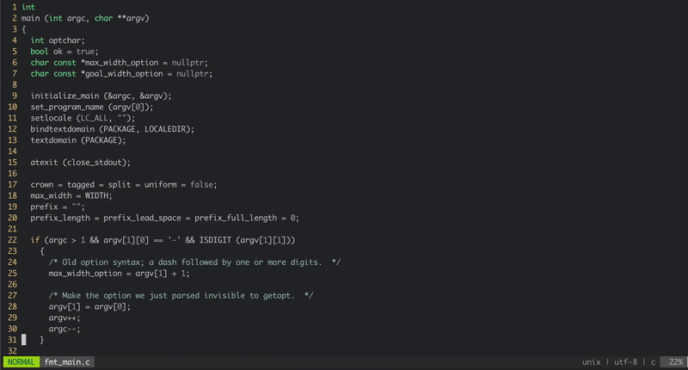
Examining fmt: main (source)

Slide 17
Examining fmt: main, arg parser (source)
int main (int argc, char **argv) { // ... switch (optchar) { default: // ... case 'c': // ... case 's': // ... case 't': // ... case 'u': // ... case 'w': // ... case 'g': // ... case 'p': // ... case_GETOPT_HELP_CHAR; // ... case_GETOPT_VERSION_CHAR(...); // ... } // ... }

Slide 18
Examining fmt: source vs IDA 9
int main (int argc, char **argv) { // ... switch (optchar) { default: // ... case 'c': // ... case 's': // ... case 't': // ... case 'u': // ... case 'w': // ... case 'g': // ... case 'p': // ... case_GETOPT_HELP_CHAR; // ... case_GETOPT_VERSION_CHAR(...); // ... } // ... }
int __cdecl main(int argc, const char **argv, const char **envp) { // ... if ( v8 == 112 ) { // ... } else if ( v8 <= 112 ) { if ( v8 == -130 ) // ... if ( v8 <= -130 ) { if ( v8 == -131 ) { // ... } LABEL_53: // ... } if ( v8 == 99 ) { // ... } else { if ( v8 != 103 ) goto LABEL_53; // ... } } else if ( v8 == 116 ) { // ... } else if ( v8 <= 116 ) { if ( v8 != 115 ) goto LABEL_53; // ... } else if ( v8 == 117 ) { // ... } else { if ( v8 != 119 ) goto LABEL_53; // ... } // ... }

Slide 19
Examining fmt: where did the Switch go?!?
int main (int argc, char **argv) { // ... switch (optchar) { default: // ... case 'c': // ... case 's': // ... case 't': // ... case 'u': // ... case 'w': // ... case 'g': // ... case 'p': // ... case_GETOPT_HELP_CHAR; // ... case_GETOPT_VERSION_CHAR(...); // ... } // ... }
int __cdecl main(int argc, const char **argv, const char **envp) { // ... if ( v8 == 112 ) { // ... } else if ( v8 <= 112 ) { if ( v8 == -130 ) // ... if ( v8 <= -130 ) { if ( v8 == -131 ) { // ... } LABEL_53: // ... } if ( v8 == 99 ) { // ... } else { if ( v8 != 103 ) goto LABEL_53; // ... } } else if ( v8 == 116 ) { // ... } else if ( v8 <= 116 ) { if ( v8 != 115 ) goto LABEL_53; // ... } else if ( v8 == 117 ) { // ... } else { if ( v8 != 119 ) goto LABEL_53; // ... } // ... }

Slide 20
Examining fmt: more gotos…
int main (int argc, char **argv) { // ... switch (optchar) { default: // ... case 'c': // ... case 's': // ... case 't': // ... case 'u': // ... case 'w': // ... case 'g': // ... case 'p': // ... case_GETOPT_HELP_CHAR; // ... case_GETOPT_VERSION_CHAR(...); // ... } // ... }
int __cdecl main(int argc, const char **argv, const char **envp) { // ... if ( v8 == 112 ) { // ... } else if ( v8 <= 112 ) { if ( v8 == -130 ) // ... if ( v8 <= -130 ) { if ( v8 == -131 ) { // ... } LABEL_53: // ... } if ( v8 == 99 ) { // ... } else { if ( v8 != 103 ) goto LABEL_53; // ... } } else if ( v8 == 116 ) { // ... } else if ( v8 <= 116 ) { if ( v8 != 115 ) goto LABEL_53; // ... } else if ( v8 == 117 ) { // ... } else { if ( v8 != 119 ) goto LABEL_53; // ... } // ... }

Slide 21
Examining fmt: main, width sanitizer (source)
int main (int argc, char **argv) { // ... if (max_width_option) { max_width = xdectoumax(...); } if (goal_width_option) { goal_width = xdectoumax(...); if (max_width_option == NULL) max_width = goal_width + 10; } else { goal_width = max_width * (2 * (100 - LEEWAY) + 1) / 200; } // ... }

Slide 22
Examining fmt: source vs IDA 9
int main (int argc, char **argv) { // ... if (max_width_option) { max_width = xdectoumax(...); } if (goal_width_option) { goal_width = xdectoumax(...); if (max_width_option == NULL) max_width = goal_width + 10; } else { goal_width = max_width * (2 * (100 - LEEWAY) + 1) / 200; } // ... }
int __cdecl main(int argc, const char **argv) { // ... if ( v3 ) { v12 = dcgettext(...); v13 = xdectoumax(..., v12); max_width = v13; if ( v7 ) { v14 = dcgettext(...); goal_width = xdectoumax(..., v14); goto LABEL_37; } goto LABEL_50; } if ( !v7 ) { LABEL_50: goal_width = 187 * max_width / 200; goto LABEL_37; } v27 = dcgettext(...); goal_width = xdectoumax(..., v27); max_width = goal_width + 10; LABEL_37: // ... }

Slide 23
Examining fmt: source vs IDA 9
int main (int argc, char **argv) { // ... if (max_width_option) { max_width = xdectoumax(...); } if (goal_width_option) { goal_width = xdectoumax(...); if (max_width_option == NULL) max_width = goal_width + 10; } else { goal_width = max_width * (2 * (100 - LEEWAY) + 1) / 200; } // ... }
int __cdecl main(int argc, const char **argv) { // ... if ( v3 ) { v12 = dcgettext(...); v13 = xdectoumax(..., v12); max_width = v13; if ( v7 ) { v14 = dcgettext(...); goal_width = xdectoumax(..., v14); goto LABEL_37; } goto LABEL_50; } if ( !v7 ) { LABEL_50: goal_width = 187 * max_width / 200; goto LABEL_37; } v27 = dcgettext(...); goal_width = xdectoumax(..., v27); max_width = goal_width + 10; LABEL_37: // ... }

Slide 24
Examining fmt: source vs IDA 9
int main (int argc, char **argv) { // ... if (max_width_option) { max_width = xdectoumax(...); } if (goal_width_option) { goal_width = xdectoumax(...); if (max_width_option == NULL) max_width = goal_width + 10; } else { goal_width = max_width * (2 * (100 - LEEWAY) + 1) / 200; } // ... }
int __cdecl main(int argc, const char **argv) { // ... if ( v3 ) { v12 = dcgettext(...); v13 = xdectoumax(..., v12); max_width = v13; if ( v7 ) { v14 = dcgettext(...); goal_width = xdectoumax(..., v14); goto LABEL_37; } goto LABEL_50; } if ( !v7 ) { LABEL_50: goal_width = 187 * max_width / 200; goto LABEL_37; } v27 = dcgettext(...); goal_width = xdectoumax(..., v27); max_width = goal_width + 10; LABEL_37: // ... }

Slide 25
What is going on here?

Slide 26
How Decompilers Make Linear Code
int v1;
if (v1) puts("hello!"); puts("goodbye"); return 0;

Slide 27
Control Flow Structuring: Graph Pattern Matching
Decompilation
if (a) puts("1"); puts("2");
if (a) puts("1"); else puts("2"); puts("3")
switch(a) { case 1: break; case 2: break; default: break; } puts("1");
do { puts("1"); } while(a); puts("2");

Slide 28
Structuring Example

Slide 29
Structuring Example
Start bottom up

Slide 30
Structuring Example
if-then-else

Slide 31
Structuring Example
if-then-else

Slide 32
Structuring Example
if-then-else

Slide 33
Structuring Example
if-then
if-then-else

Slide 34
Structuring Example
if-then
if-then-else

Slide 35
Structuring Example
if-then
if-then-else

Slide 36
Structuring Example
if-then
We’re out of structures to match! This causes a failure.
if-then-else

Slide 37
Structuring Example
Pretend this edge does not exist (“virtualization”)
if-then-else

Slide 38
Structuring Example
sequence
Pretend this edge does not exist (“virtualization”)
if-then-else

Slide 39
Structuring Example
sequence
Pretend this edge does not exist (“virtualization”)
if-then-else

Slide 40
Structuring Example
sequence
Pretend this edge does not exist (“virtualization”)
if-then-else

Slide 41
Structuring Example
if (a) goto B; // ... if (b) { B: // ... } else { // ... }

Slide 42
Failed Structuring Results in Gotos
if (a) goto B; // ... if (b) { B: // ... } else { // ... }

Slide 43
What Causes Failures?
switch(a) { case 1: break; case 2: break; default: break; } puts("1");
switch
Expected

Slide 44

What Causes Failures? Unknown Patterns!
switch(a) { case 1: break; case 2: break; default: break; } puts("1");
switch
Reality
$$≠$$

Slide 45
What Causes Unknown Patterns? Compiler Optimizations!
switch(a) { case 1: break; case 2: break; default: break; } puts("1");
Optimization

Slide 46
How To Know An Optimization (Likely) Occurred
if (a) goto B; // ... if (b) { B: // ... } else { // ... }
int __cdecl main(int argc, const char **argv, const char **envp) { if ( v8 != 103 ) goto LABEL_53; // ... } } else if ( v8 == 116 ) { // ... } else if ( v8 <= 116 ) { if ( v8 != 115 ) goto LABEL_53; // ... } else if ( v8 == 117 ) { // ... } else { if ( v8 != 119 ) goto LABEL_53; // ... } }
int __cdecl main(int argc, const char **argv) { // ... if ( v3 ) { v12 = dcgettext(...); v13 = xdectoumax(..., v12); max_width = v13; if ( v7 ) { v14 = dcgettext(...); goal_width = xdectoumax(..., v14); goto LABEL_37; } goto LABEL_50; } if ( !v7 ) { LABEL_50: goal_width = 187 * max_width / 200; goto LABEL_37; } // ... }

Slide 47
How To Know An Optimization (Likely) Occurred
if (a) goto B; // ... if (b) { B: // ... } else { // ... }
int __cdecl main(int argc, const char **argv, const char **envp) { if ( v8 != 103 ) goto LABEL_53; // ... } } else if ( v8 == 116 ) { // ... } else if ( v8 <= 116 ) { if ( v8 != 115 ) goto LABEL_53; // ... } else if ( v8 == 117 ) { // ... } else { if ( v8 != 119 ) goto LABEL_53; // ... } }
int __cdecl main(int argc, const char **argv) { // ... if ( v3 ) { v12 = dcgettext(...); v13 = xdectoumax(..., v12); max_width = v13; if ( v7 ) { v14 = dcgettext(...); goal_width = xdectoumax(..., v14); goto LABEL_37; } goto LABEL_50; } if ( !v7 ) { LABEL_50: goal_width = 187 * max_width / 200; goto LABEL_37; } // ... }

Slide 48
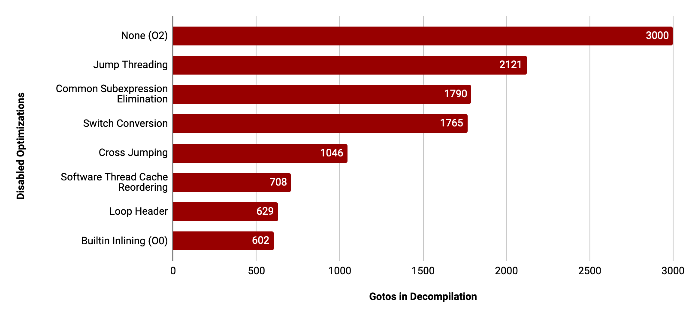
Compiler Optimizations And Gotos (Failures)

Slide 49
Compiler Optimizations And Gotos (Failures)
Only 7 optimizations cause 80% of gotos

Slide 50
Compiler Optimizations And Gotos (Failures)

Slide 51
3 Observed Types of Compiler Optimizations
Optimization
Decompiler Effect
Jump Threading
STCR
Loop Header
CSE
Switch Conversion
Cross Jumping
Builtin Inlining
Switch Lowering
Non-Ret Functions
Code Duplication
Code Merging
Code Movement/Other

Slide 52
Compiler Optimization Summary
You can find optimization locations with gotos (It’s not 100% lossy!)
Not all optimizations are the same level of destructive
There is a reasonably limited amount that causes destruction
Solution: identify and reverse the most impactful!

Slide 53
Plundering Compiler Optimizations

Slide 54
fmt: The Evil Switch
int main (int argc, char **argv) { // ... switch (optchar) { default: // ... case 'c': // ... case 's': // ... case 't': // ... case 'u': // ... case 'w': // ... case 'g': // ... case 'p': // ... case_GETOPT_HELP_CHAR; // ... case_GETOPT_VERSION_CHAR(...); // ... } // ... }
int __cdecl main(int argc, const char **argv, const char **envp) { // ... if ( v8 == 112 ) { // ... } else if ( v8 <= 112 ) { if ( v8 == -130 ) // ... if ( v8 <= -130 ) { if ( v8 == -131 ) { // ... } LABEL_53: // ... } if ( v8 == 99 ) { // ... } else { if ( v8 != 103 ) goto LABEL_53; // ... } } else if ( v8 == 116 ) { // ... } else if ( v8 <= 116 ) { if ( v8 != 115 ) goto LABEL_53; // ... } else if ( v8 == 117 ) { // ... } else { if ( v8 != 119 ) goto LABEL_53; // ... } // ... }

Slide 55
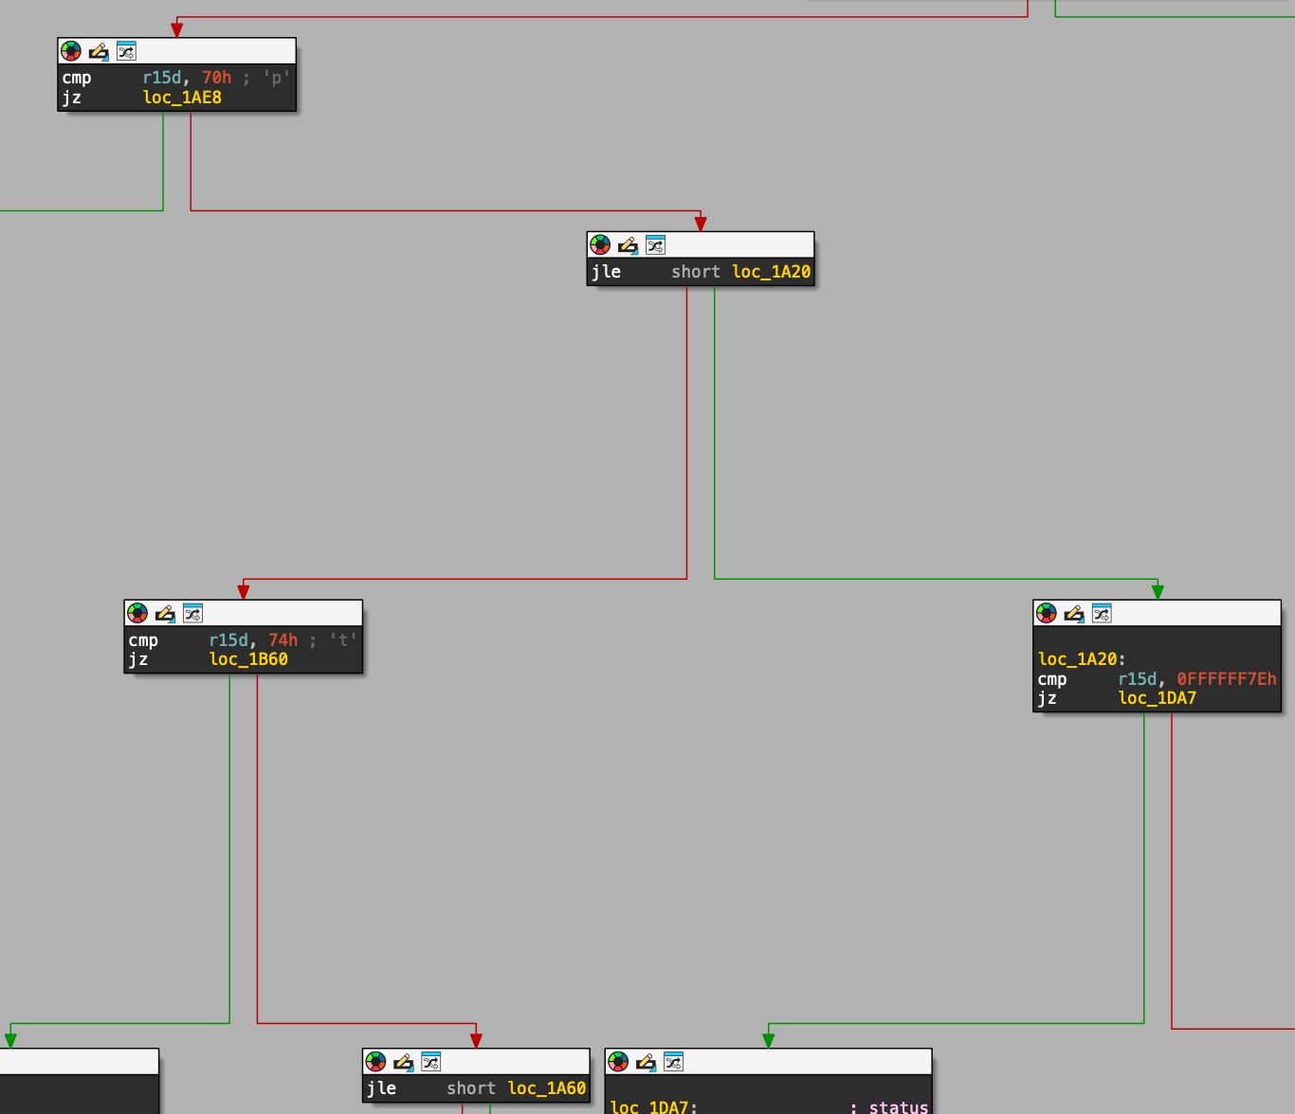
The Evil Switch: Switch Lowering Optimization
int main (int argc, char **argv) { // ... switch (optchar) { default: // ... case 'c': // ... case 's': // ... case 't': // ... case 'u': // ... case 'w': // ... case 'g': // ... case 'p': // ... case_GETOPT_HELP_CHAR; // ... case_GETOPT_VERSION_CHAR(...); // ... } // ... }

Slide 56
Switch Lowering Optimization (simplified)
Minimizes the number of jumps for a non-consecutive Switch
Converts what would be many tables into an if-tree
Has existed since the early 2000s
Can’t be disabled in GCC (exists in O0)

Slide 57
The Switch Lowering Pattern
int main (int argc, char **argv) { // ... switch (optchar) { default: // ... case 'c': // ... case 's': // ... case 't': // ... case 'u': // ... case 'w': // ... case 'g': // ... case 'p': // ... case_GETOPT_HELP_CHAR; // ... case_GETOPT_VERSION_CHAR(...); // ... } // ... }
v1
v1 != N
CODE
v1 < M
goto*
CODE
CODE

Slide 58
The Mythical Calls: Jump Threading
int main (int argc, char **argv) { // ... if (max_width_option) { max_width = xdectoumax(...); } if (goal_width_option) { goal_width = xdectoumax(...); if (max_width_option == NULL) max_width = goal_width + 10; } else { goal_width = max_width * (2 * (100 - LEEWAY) + 1) / 200; } // ... }
int __cdecl main(int argc, const char **argv) { // ... if ( v3 ) { v12 = dcgettext(...); v13 = xdectoumax(..., v12); max_width = v13; if ( v7 ) { v14 = dcgettext(...); goal_width = xdectoumax(..., v14); goto LABEL_37; } goto LABEL_50; } if ( !v7 ) { LABEL_50: goal_width = 187 * max_width / 200; goto LABEL_37; } v27 = dcgettext(...); goal_width = xdectoumax(..., v27); max_width = goal_width + 10; LABEL_37: // ... }

Slide 59
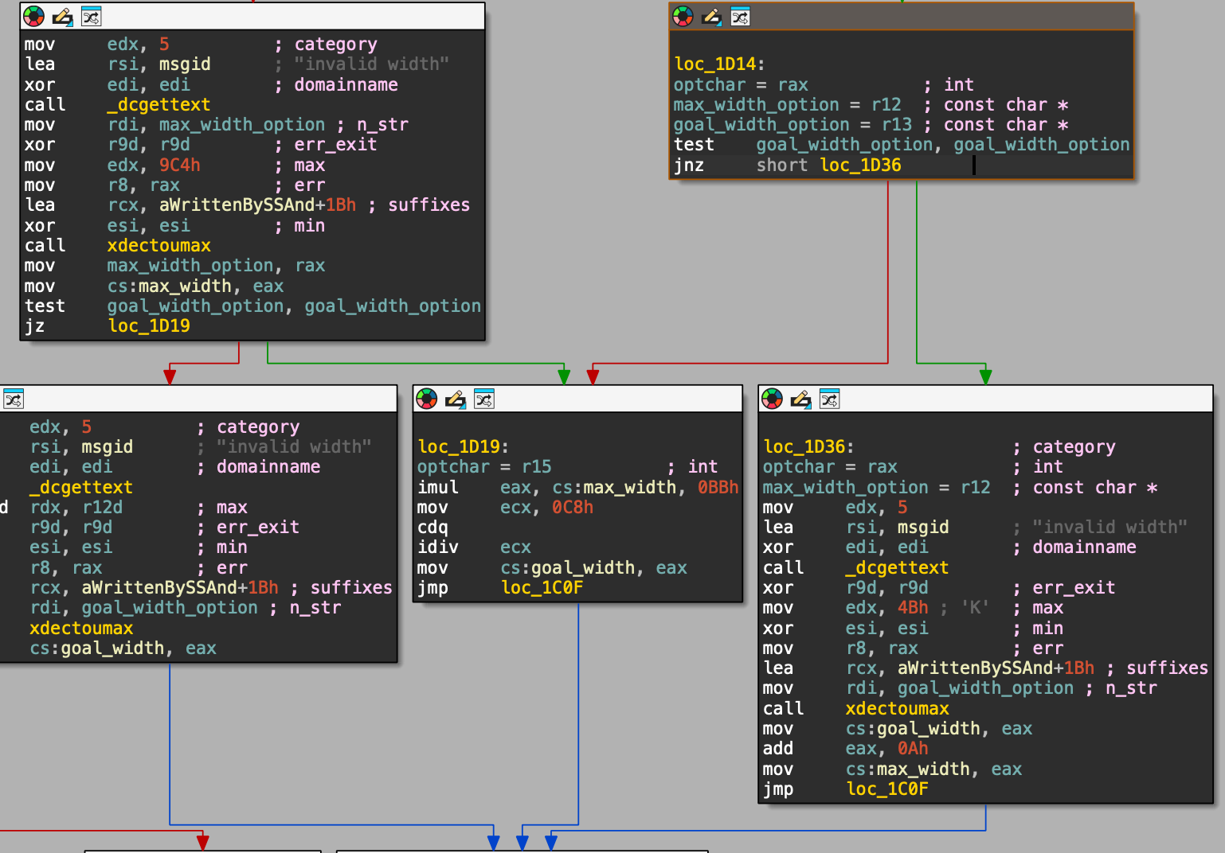
The Mythical Calls: Jump Threading
int main (int argc, char **argv) { // ... if (max_width_option) { max_width = xdectoumax(...); } if (goal_width_option) { goal_width = xdectoumax(...); if (max_width_option == NULL) max_width = goal_width + 10; } else { goal_width = max_width * (2 * (100 - LEEWAY) + 1) / 200; } // ... }

Slide 60
Jump Threading (Simplified)
if (v1 && v2) { puts("1"); puts("2"); goto B; } puts("2"); if (v2) { B: puts("3"); } return 0;
Overlapping Conditions
if (a && b) puts("1"); puts("2"); if (b) puts("3"); return 0;

Slide 61
Jump Threading (Simplified)
if (v1 && v2) { puts("1"); puts("2"); goto B; } puts("2"); if (v2) { B: puts("3"); } return 0;
Overlapping Conditions
Copy Overlapped Code
if (a && b) puts("1"); puts("2"); if (b) puts("3"); return 0;
Jump To Overlapping Condition

Slide 62
The Mythical Calls: Jump Threading
int main (int argc, char **argv) { // ... if (max_width_option) { max_width = xdectoumax(...); } if (goal_width_option) { goal_width = xdectoumax(...); if (max_width_option == NULL) max_width = goal_width + 10; } else { goal_width = max_width * (2 * (100 - LEEWAY) + 1) / 200; } // ... }
Overlapping condition checks

Slide 63
Jump Threading (Simplified)
Minimizes the number of conditional jumps when overlapping conditions are detected
Enabled in O2
Can duplicate around 15 code statements before stopping

Slide 64
Jump Threading Pattern
int main (int argc, char **argv) { // ... if (max_width_option) { max_width = xdectoumax(...); } if (goal_width_option) { goal_width = xdectoumax(...); if (max_width_option == NULL) max_width = goal_width + 10; } else { goal_width = max_width * (2 * (100 - LEEWAY) + 1) / 200; } // ... }
…
…
DUPE CODE
DUPE CODE
…
…
goto

Slide 65
IS THIS ALL REAL?

Slide 66
DEMO: angr decompiler

Slide 67
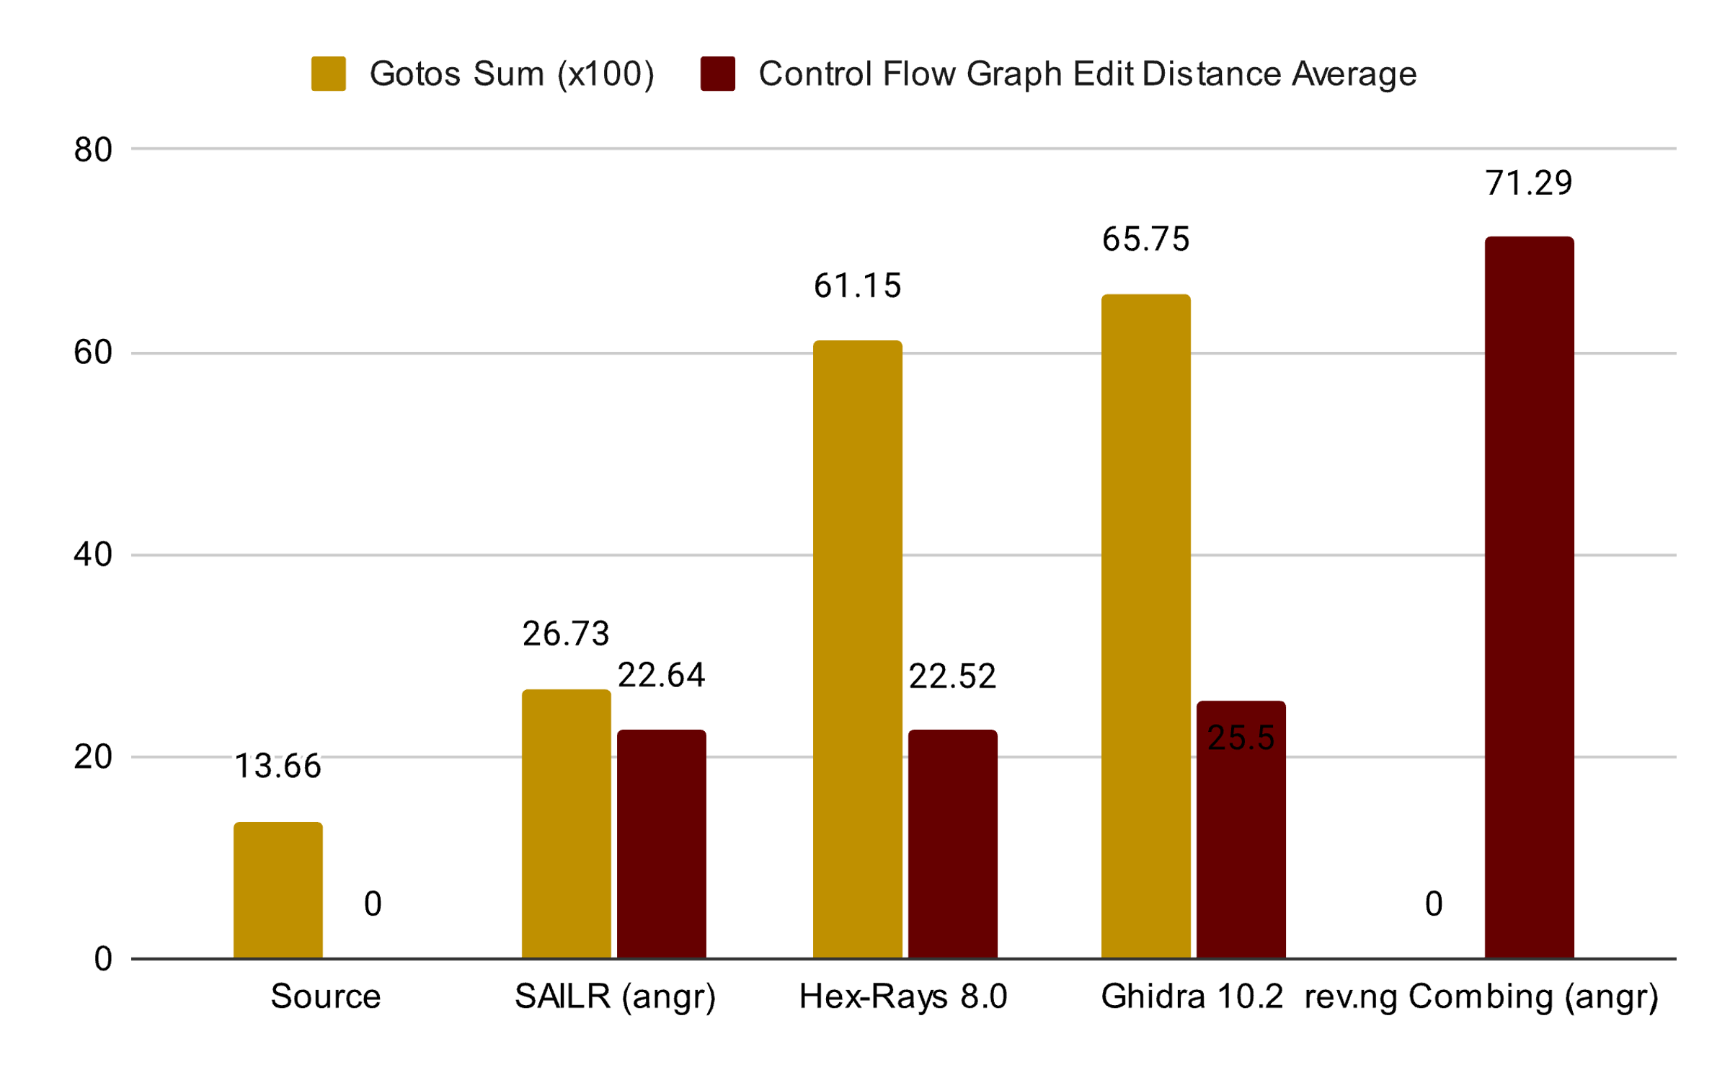
Deoptimizing At Scale
Keeps failures (gotos) low, while maintaining source similarity

Slide 68
All Deoptimizations
We created reverse algorithms for all optimization classes
We tested on GCC, Clang, MSVC, and some malware
Algorithms and code open-source:
https://github.com/mahaloz/sailr-eval
“Ahoy SAILR! There is No Need to DREAM of C: A Compiler-Aware Structuring Algorithm for Binary Decompilation”, USENIX 2024

Slide 69
Benefiting from This Talk (1): REBEL! DEMAND BETTER!
Modern decompilers (IDA, Binja, Ghidra) don’t give API access to structuring choices… Ask for it!
Large developers/funders of decompilers ignore ”interactive” or “tunable” decompilers… Demand it!
Alternative: maybe instruction-level rewriting?

Slide 70
Benefiting from This Talk (2): Try angr decompiler!
User angr decompiler (GUI): https://github.com/angr/angr-management, where we implemented every algorithm
Open-source, command line, GUI, hackable
Limitations: made by wacky academics, slower (python), hackable sometimes means crashable

Slide 71

Thank You for Listening
Zion Leonahenahe Basque
zbasque@asu.edu
@mahal0z
angr decompiler
pip install angr angr decompile /bin/true

